Slide 1
Retail Demand Forecasting
30-Day Revenue and Order Volume Prediction
1

Slide 2
Objective & Data Preparation
Goal
Forecast daily_revenue and daily_order_volume for the next 30 days
Source Data
333,234 cleaned transaction rows
Coverage: 2010-12-01 to 2011-12-09
Aggregation
374 daily calendar records after gap-filling missing dates
Train / Test Split
Training: first 344 days
Holdout test: final 30 days
Supporting Daily Series
line_count
daily_quantity
unique_customers
unique_stockcodes
avg_unit_price
Derived Feature Series
avg_order_value = daily_revenue / daily_order_volume
2

Slide 3
Models Compared
Seasonal Naive
Gradient Boosting
Last 7 training days repeated across 30-day horizon
Captures weekly seasonality only
No trend learning
No feature interactions
Predictions clipped at zero
Role: baseline benchmark
HistGradientBoostingRegressor
Learns non-linear relationships from engineered features
55 features total (7 calendar + lag/rolling from 8 series)
Recursive multi-step forecasting avoids exogenous leakage
7 directly modelled daily series keep support signals consistent
Hyperparameters:
learning_rate = 0.05
max_depth = 4
max_iter = 400
min_samples_leaf = 10
3

Slide 4
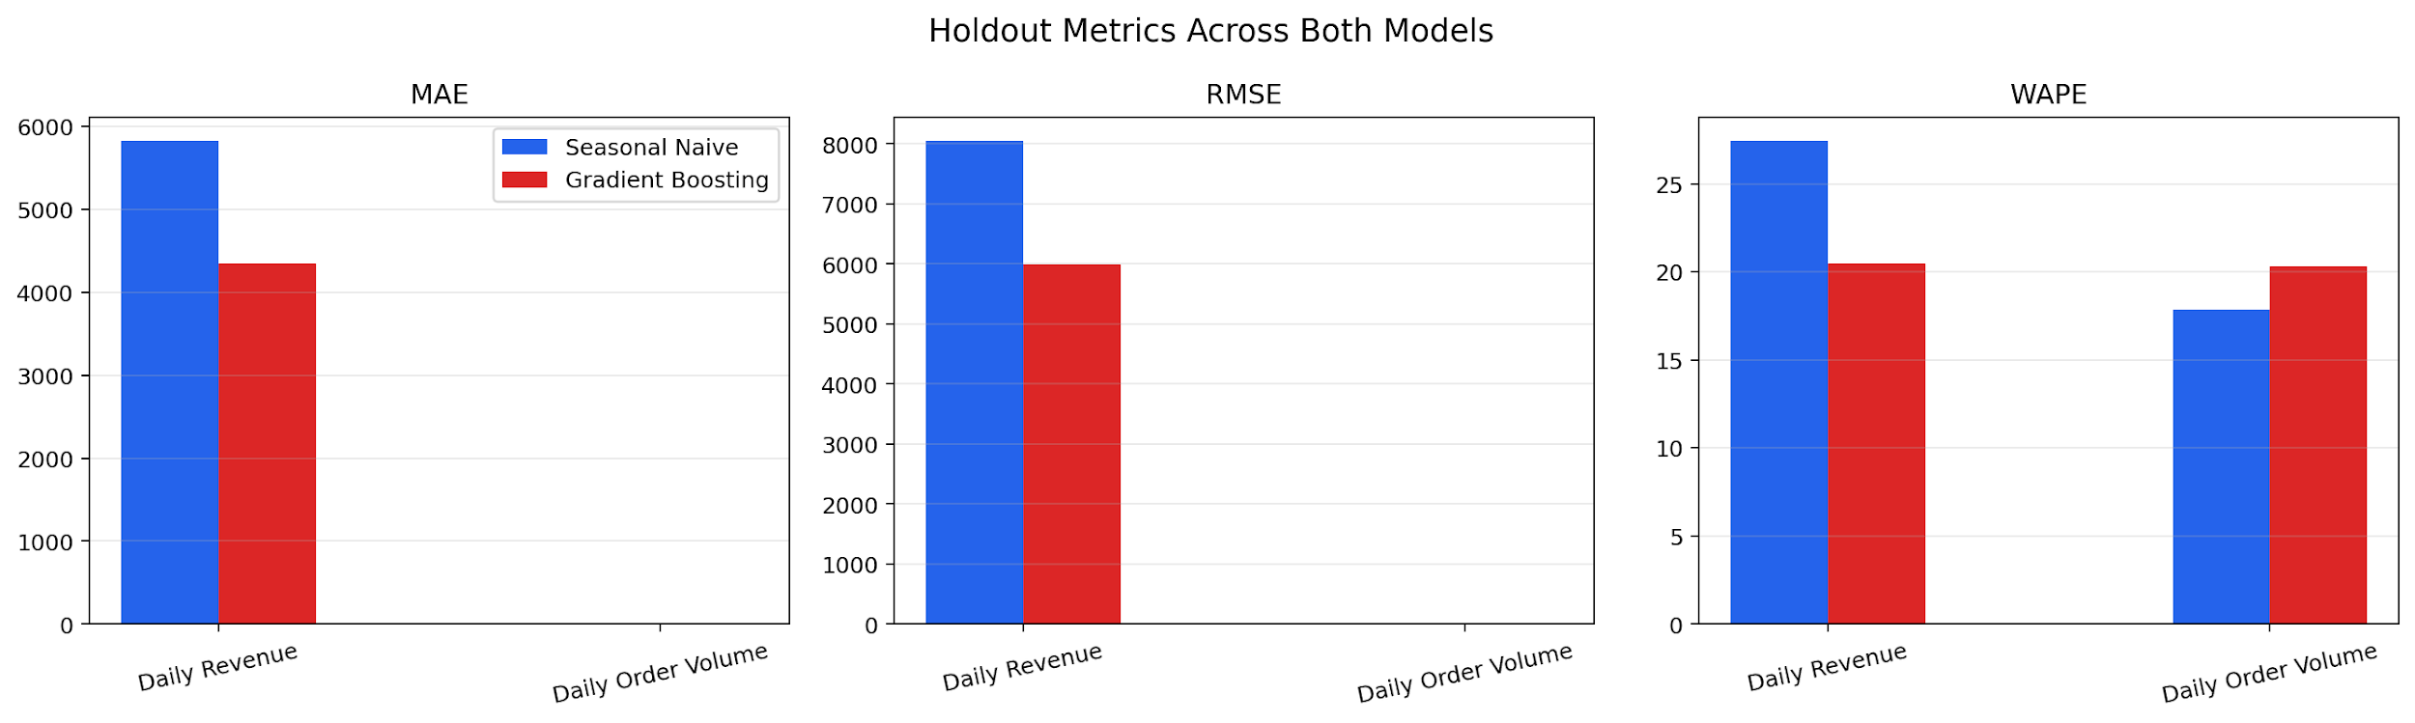
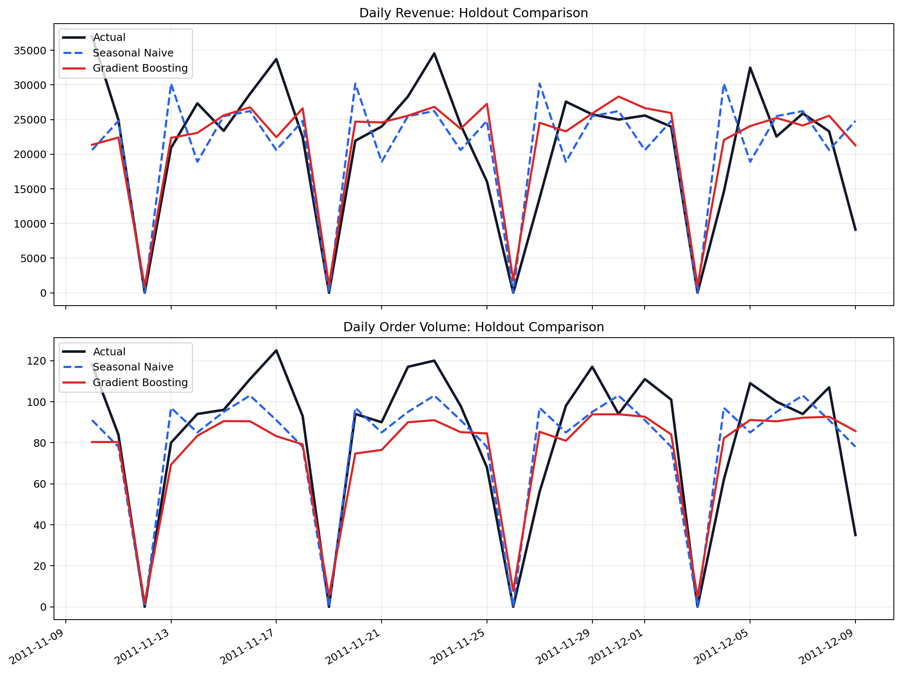
Holdout Evaluation Results
Metrics: MAE · RMSE · WAPE (%)
Target | Model | MAE | RMSE | WAPE (%)
daily_revenue | Seasonal Naive | 5 822.61 | 8 048.46 | 27.42
daily_revenue | Gradient Boosting | 4 348.53 | 5 986.90 | 20.48
daily_order_volume | Seasonal Naive | 14.70 | 19.06 | 17.84
daily_order_volume | Gradient Boosting | 16.73 | 20.53 | 20.30
Gradient Boosting selected for daily_revenue. Seasonal Naive selected for daily_order_volume.
Selection rule: lowest RMSE per target, with MAE as tiebreaker.
4

Slide 5
Why Results Are Mixed
Why GB Wins on Revenue
Why Seasonal Naive Wins on Orders
Revenue has higher variance than order volume
Revenue depends on order size, product mix, and pricing shifts
Lag and rolling features capture momentum effectively
Calendar effects add predictive value beyond a weekly repeat
Non-linear interactions improve revenue prediction
Order volume follows a stable weekly cycle
The naive weekly-repeat baseline is already very strong
Less variance to exploit with a more complex model
Recursive multi-step errors slightly degrade GB on this target
Extra complexity does not always improve a low-variance periodic series
5

Slide 6
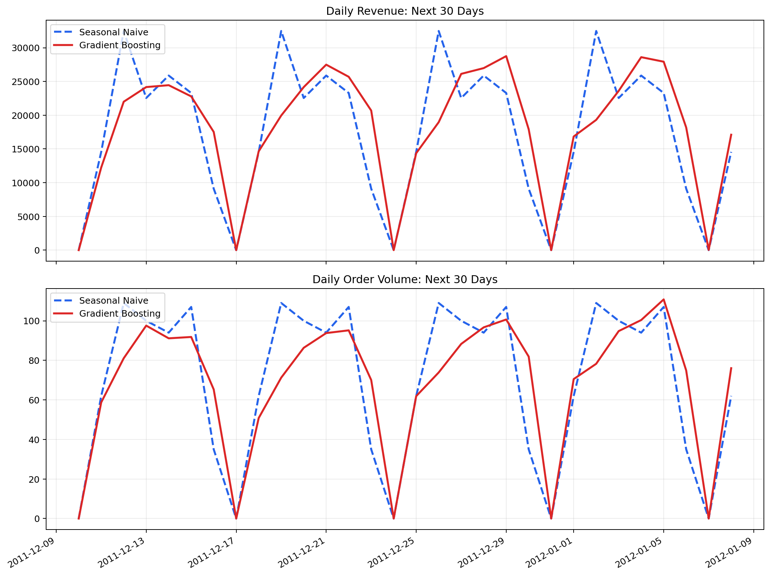
30-Day Forward Forecast
Target | Selected Model | 30-Day Total | Avg Daily | Peak Daily
daily_revenue | Gradient Boosting | 540 563.44 | 18 018.78 | 28 758.04
daily_order_volume | Seasonal Naive | 2 090.00 | 69.67 | 109.00
The pipeline deploys the best model per target — different targets can use different models simultaneously.
6

Slide 7
Limitations & Future Improvements
Limitations
Future Improvements
Only 374 calendar-day observations after daily aggregation
Recursive GB forecasts can accumulate error over 30 days
No external regressors (holidays, promotions, macro factors)
Weekly seasonality modeled, broader seasonal structure not explicit
Validation uses a single 30-day holdout rather than rolling time-series cross-validation
Add holidays, promotions, and macroeconomic covariates
Use rolling-origin or expanding-window validation
Compare SARIMAX, Prophet, and LSTM-style alternatives
Add prediction intervals and uncertainty bands
Build automated tuning and forecast monitoring
7

Slide 8
Summary
Two-Model Comparison
Seasonal Naive baseline vs Gradient Boosting with 55 engineered features
Final Per-Target Selection
Gradient Boosting → daily_revenue
Seasonal Naive → daily_order_volume
Key Takeaway
Model complexity helps when the target has richer structure, but not when a stable weekly pattern already dominates
Business Value
Revenue forecasts support purchasing and cash-flow planning
Order volume forecasts support staffing and logistics planning
8

